Slide 1
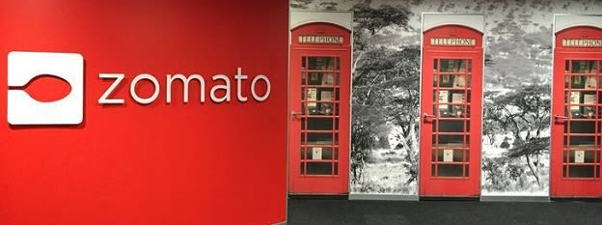
Zomato Analysis
Team 5
Rajeev Gujar
Chanchala Verma
Anam Shaikh
Neelam Sahni
This Photo by Unknown Author is licensed under CC BY-SA-NC

Slide 2
Objectives:
Familiarity with facts- Data will be studied and analysed.
Trend Analysis- A quick overview of trends and patterns.
Strategic Business Decision- On basis of analysis Better and effective decisions can be made for the growth of the company.
Operational Efficiency- Analysis will help provide business insights needed to make decisions which will increase operational efficiency.

Slide 3
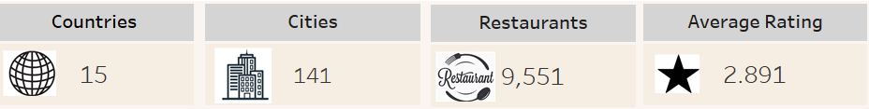
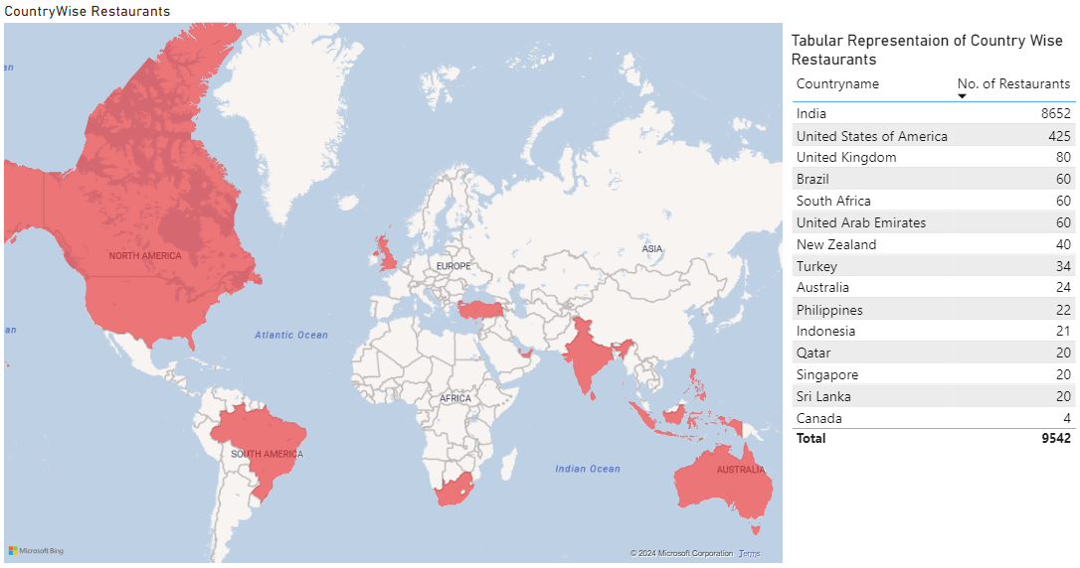

Slide 4
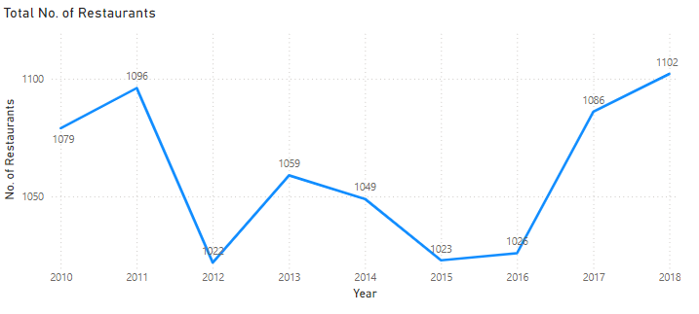
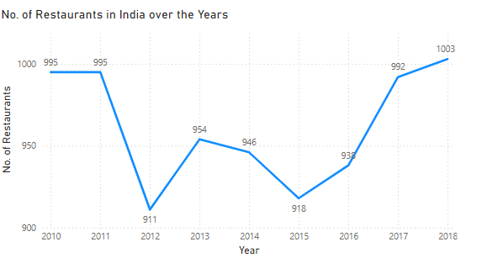
TREND ANALYSIS
GLOBALLY
Every year around 1000 to 1100 Restaurants join globally.
Overall there is Growth in the Number of Restaurants around the world engaging with Zomato each year.
But India Being an outlier in this situation dominates the number because almost every year 85% - 90% of the restaurants joining Globally are from India.
IN INDIA
There is a slight growth in the number of restaurants , We can also see a downfall in 2012 and 2015.
But in a bigger picture the end result is stagnant. Every year 900 - 1000 restaurants tie up with Zomato.
Zomato is the first food delivery app in India hence there is full potential growth available in India as compared to any other country.

Slide 5
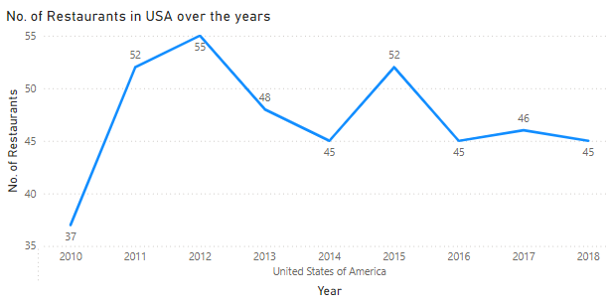
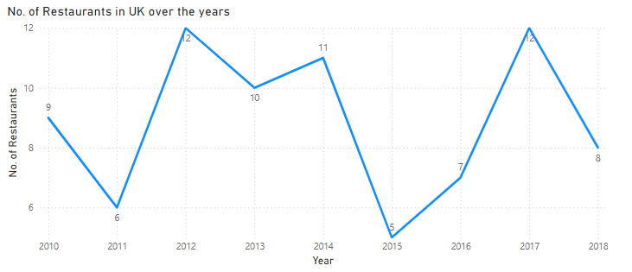
UNITED STATES OF AMERICA
In U.S.A the Count has dropped in 2018 by 18% as compared to 2012.
This is probably because there are multiple domestic food delivery app in USA such as UberEats, Grubhub etc. and around 65% of the market is dominated by DoorDash.
UNITED KINGDOM
In UK the Count in overall years is not very promise able This is probably because there are multiple domestic food delivery app in UK such as UberEats, Deliveroo, JustEat etc.

Slide 6
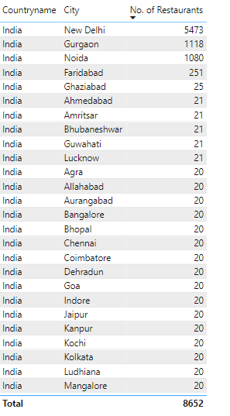
Key Points:
Approximately 89% restaurants in India are from New Delhi, Gurgaon, Noida.
Zomato is witnessing Positive response in North India.
Suggestions:
There is a lot of potential growth opportunity in India itself.
By expanding its restaurants connection in other zones starting with Metropolitan Cities such as Bangalore, Mumbai, Jaipur where count is only 20.
It will be much easier to establish roots in these cities is because the lifestyle and fondness of cuisines is similar to that of Delhiites.
Providing a few perks such as free delivery, Coupon codes, etc will help in attracting more customers and can soon recover costs.

Slide 7
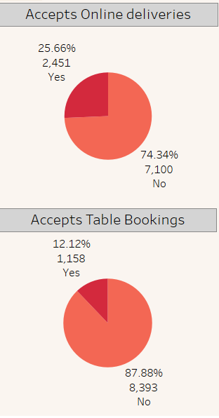
About 26% Restaurants accepts online orders and remaining 74% serves only Dining Option.
Suggestions:
More restaurants should be approached for online delivery orders.
Collaborate with popular local restaurants to offer exclusive deals and menu items.
Only 12% Restaurants accepts Table Booking.
Suggestions:
Online as well as offline table booking acceptance should be increased.
Other Restaurants should be convinced to accept Table Bookings via the app.
Utilize social media platforms to run targeted ads.

Slide 8
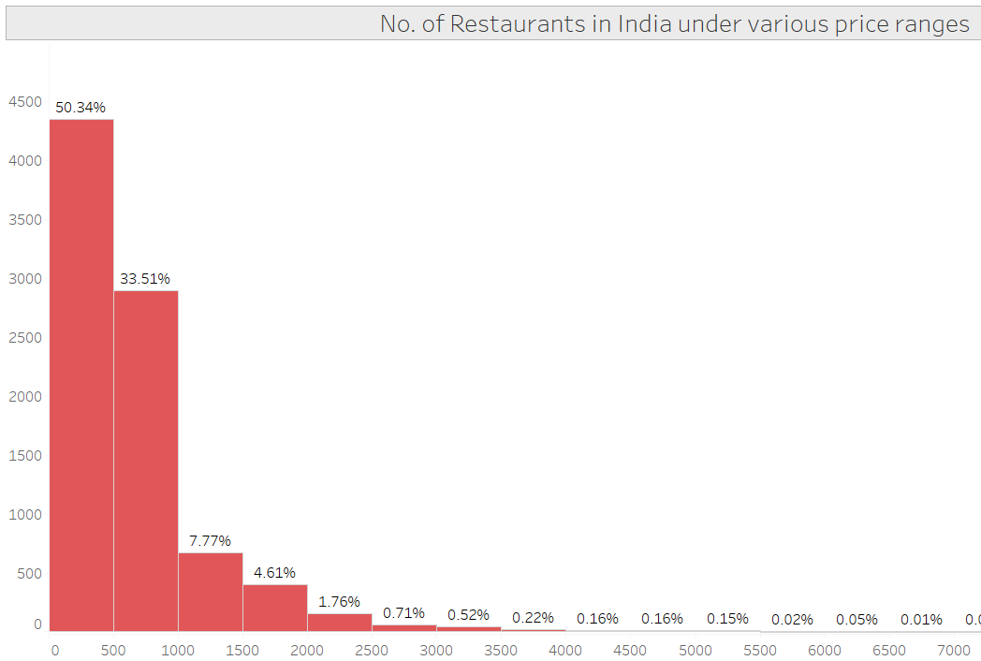

Pricing Insights
All prices have been converted to INR.
Visualizations depicting the ratings and pricing bucket distributions.
Majority of restaurants fall within the 0-500 price bucket, indicating a focus on affordable dining options.
Sweet spot
This Photo by Unknown Author is licensed under CC BY-SA

Slide 9
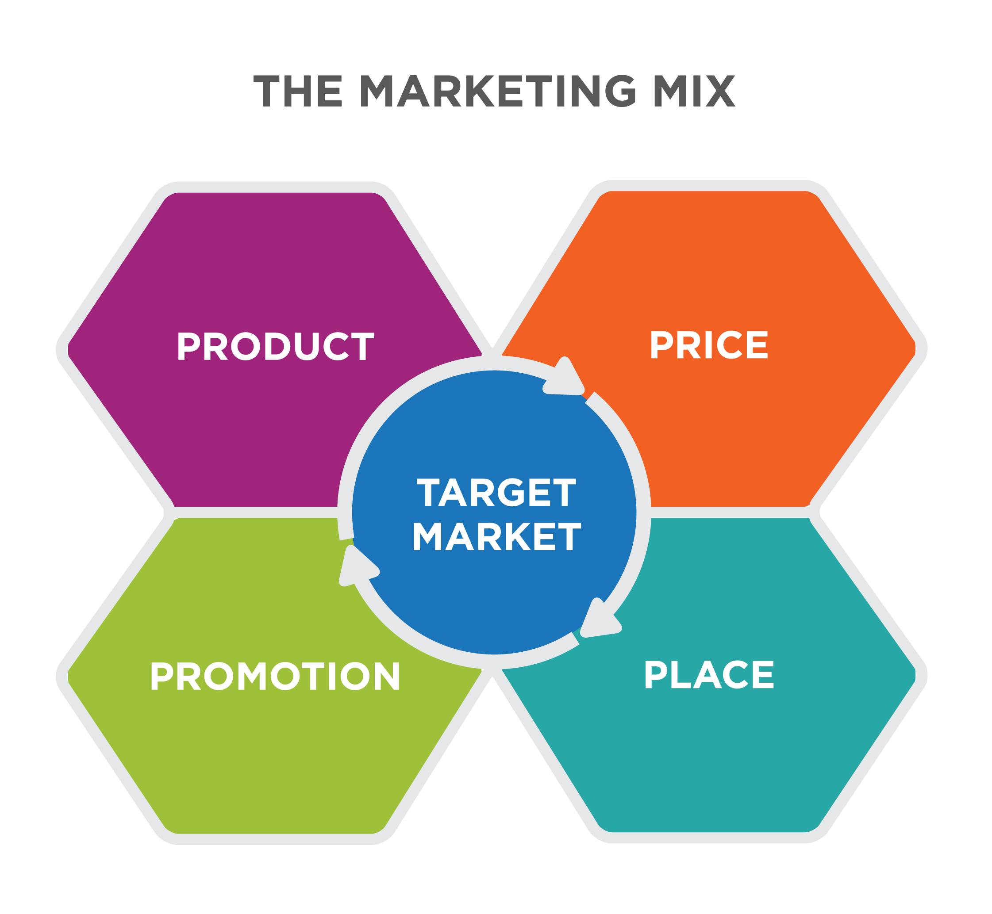
Pricing Insights:
60% of restaurants are in the 0-500 price bucket, 25% in the 500-1000 bucket, and the remaining 15% spread across higher price ranges
The predominance of affordable dining options suggests the target market is price-conscious consumers
However, the presence of restaurants in higher price buckets (1000-1500, 1500-2000) indicates the company also caters to a segment of customers seeking premium dining experiences
Pricing Recommendations:
Tailor marketing efforts to highlight the affordable dining options, as this appears to be the primary focus
Explore opportunities to partner with or feature more high-end restaurants to cater to the demand for premium dining

Slide 10
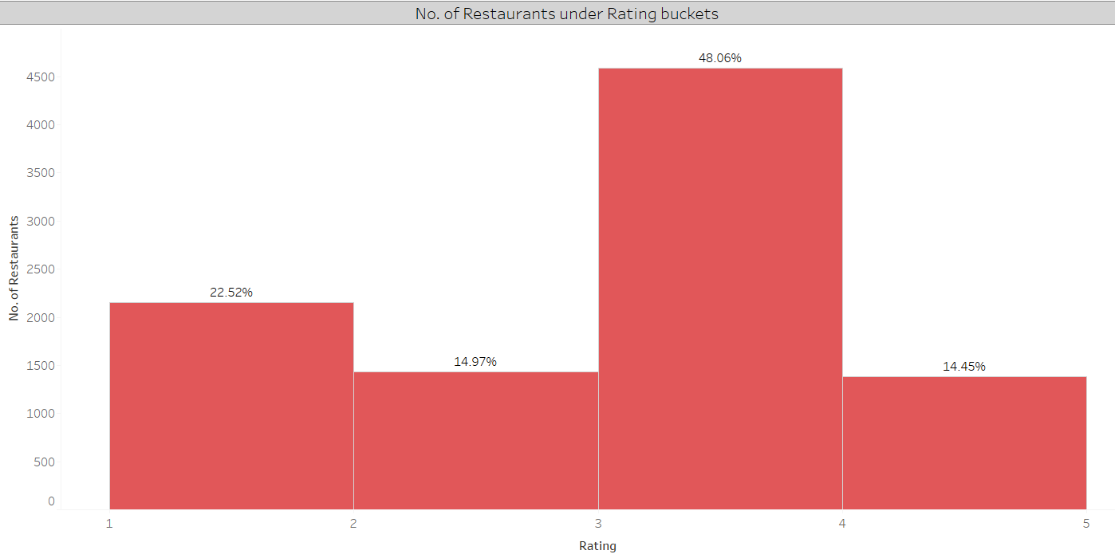
Ratings
Approximately 50% of restaurants fall under the 3-4 rating bucket.
Improvement Opportunities -
Implement programs to assist lower-rated restaurants in improving service, food quality, and customer satisfaction.
Encourage restaurants to actively solicit feedback and implement continuous improvement measures.
The application should have –
Review page for restaurants after ordering.
User-friendly app interface and customer support.
Popular options and Top rated-picks to help users pick a restaurant.

Slide 11
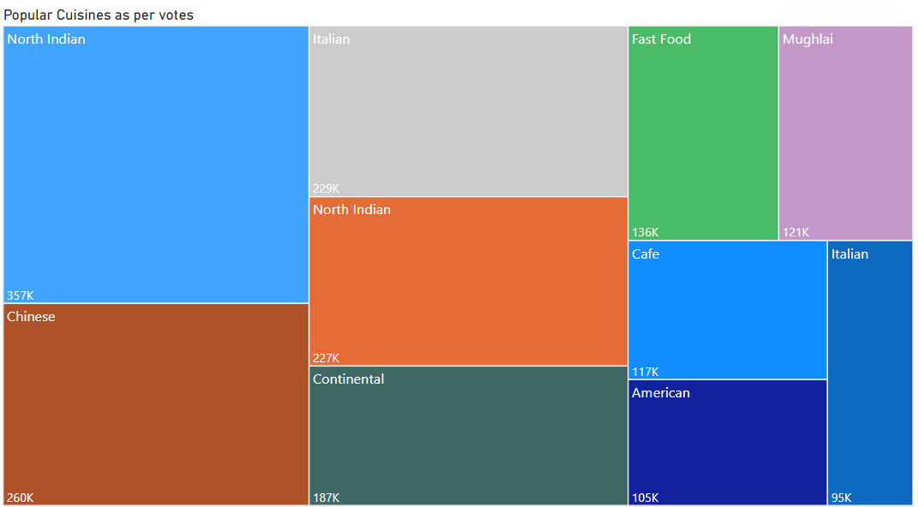
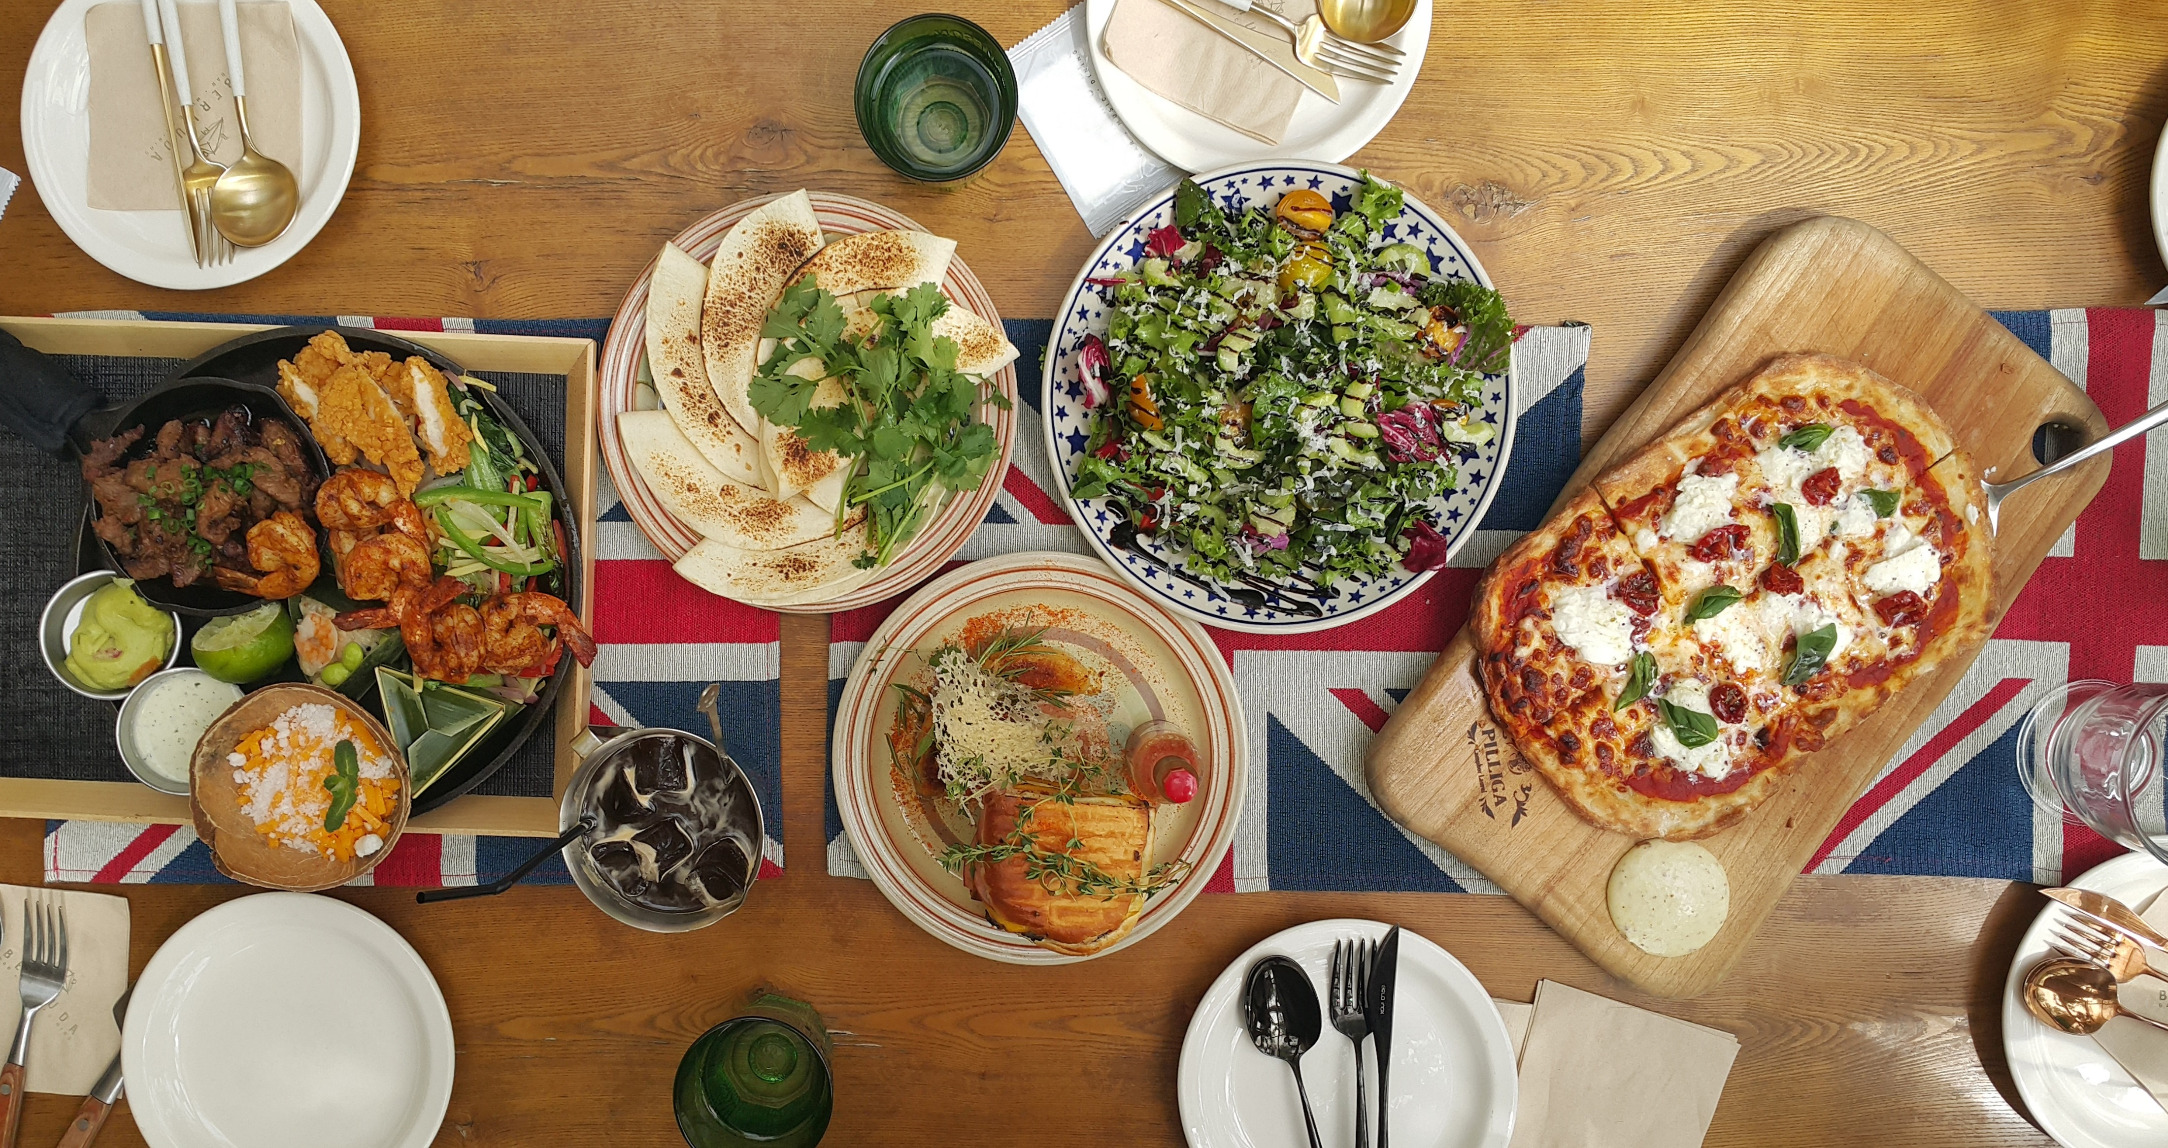
Cuisines
The dataset shows a diverse range of cuisines, with the top 3 being North Indian, Chinese and Italian.

Slide 12
Recommendations
Leverage the popularity of certain cuisines to attract customers and expand the restaurant network
Identify underserved cuisine types or locations to diversify the offerings and reach new customer segments

Slide 13
Recommendations
Optimize the Restaurant Network:
Leverage the insights on geographic distribution to identify and target underserved markets for expansion
Explore partnerships or acquisitions to strengthen the presence in high-potential cities and countries
Enhance Customer Experience:
Implement programs to assist lower-rated restaurants in improving service, food quality, and overall customer satisfaction
Encourage restaurants to actively solicit customer feedback and implement continuous improvement measures
Diversify the Offering:
Capitalize on the popularity of certain cuisines to attract customers and expand the restaurant network
Identify underserved cuisine types or locations to diversify the offerings and reach new customer segments
Promote Digital Transformation:
Develop strategies to increase the adoption of table booking and online delivery services among partner restaurants
Leverage technology to provide a seamless and personalized dining experience for customers

Slide 14
Conclusion
Diverse geographic distribution of restaurants, with opportunities for expansion in underserved markets.
Predominance of affordable dining options, but also a presence of premium restaurants catering to different customer segments.
Varying levels of customer satisfaction, with potential quality gaps that can be addressed.
Adoption of table booking and online delivery services still has room for improvement.

Slide 15

Thank You

